Slide 1
Utilizing LSTMs to Generate Music
By Luke Feng and Kevin Loun

Slide 2
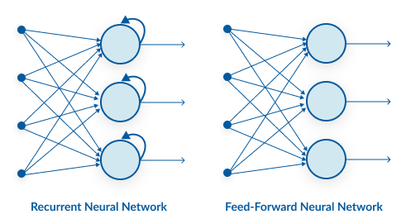
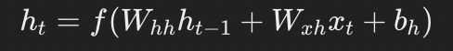
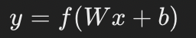
Recurrent Neural Networks
Variable-length sequences as inputs/outputs
Utilizes sequential information
Hidden State
Acts as the memory of network
The hidden state at time t, ht, is updated based on the prior hidden state ht−1 and the current input xt
Outputs independent of prior computation in regular NN

Slide 3
Vanishing Gradient Problem
Phenomenon where gradients of loss function become increasingly small as the error is propagated back through layers
Results in minimal updates to weights of earlier layers
Hindering the network’s ability to learn long-range dependencies
Issue becomes pronounced in networks using activation functions like the sigmoid
derivatives can take on small values
when derivatives are multiplied through the layers, the product can become exceedingly small, leading to gradients that are practically zero, hence “Vanishing Gradient”
hard for the RNN to learn correlations between events that are far apart in time.

Slide 4
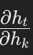
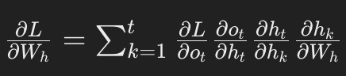
Vanishing Gradient Problem
Given loss function L
For a given time step t, calculate gradient of loss L
Due to recurrent nature of RNN, must unroll network through time and apply chain rule to compute gradients at each time step
each time step's operations become separate, sequential operations
Applying Chain Rule
gradient of the loss L calculated by considering direct influence of W h ​ on L at time t and its influence through the hidden state's effect on future time steps
captures influence of hidden state at time k on hidden state at time t
recursively applying the derivative through the unrolled network.
Through many layers, gradients vanish as they are propagate through the unrolled network

Slide 5
LSTM
Subset of recurrent Neural network
Advantages
Access to the entire sequence
ability to learn long-term dependencies.
No vanishing gradient problem
Structure
Forget Gate
Input Gate & Candidate Cell State
Cell State Update
Output Gate
Notes:
Input Gate
which parts of the cell state to retain or discard.
Forget Gate
Decides which new information to add to the cell state.
Cell State Update
Updates the cell state by forgetting and adding information.
Output Gate
Determines the next hidden state.

Slide 6
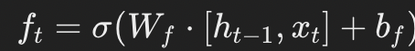
LSTM Forget Gate
Selective Memory
Decides which new information to throw away
reducing risk of saturating the gradient during backpropagation.
Made based on current input, xt, and prior hidden state ht-1
Sigmoid outputs 0 (forget this info), or 1 (retain this info)

Slide 7
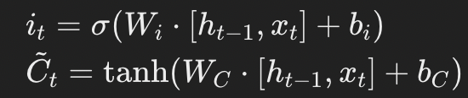
LSTM Input Gate & Candidate Cell State
Determining what new information to add to cell state.
Wi & bi ​ are weight and bias specific to the input gate
Candidate cell state, ct, creates vector of candidate values that could be added to the cell state
Tanh function outputs values between -1 and 1, representing potential updates to cell state

Slide 8
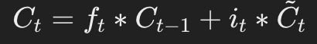
Cell State Update
Combines Forget and Input Gates
Decided what information is important and what’s not
Update cell state based on this
Shows how we combine past cell state (Ct-1) with new candidate values.
Ft forgets, it adds information

Slide 9
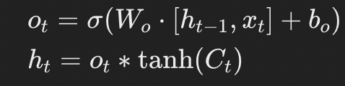
LSTM Output Gate
Determines what part of cell state to output
W o Weight matrix associated with the output gate.
b o ​ : Bias term for the output gate.
Similar to input gate, sigmoid ensuring the output gate's activations are between 0 (block info) and 1 (pass info).
Multiplying output gate to apply decision on what to output

Slide 10
How does this solve the problem?
Cell State as gradient highway
allows gradients to flow across time steps with minimal alteration
Achieves this by carrying information straight down the sequence
Gates only modulating information
Traditional RNNs typically transform through activation functions that can squash gradients
Because gradients don’t change, LSTMs can learn long range dependencies
LSTMs' ability to learn and remember over long sequences makes them significantly better suited for capturing the complexity and nuance of musical composition

Slide 11
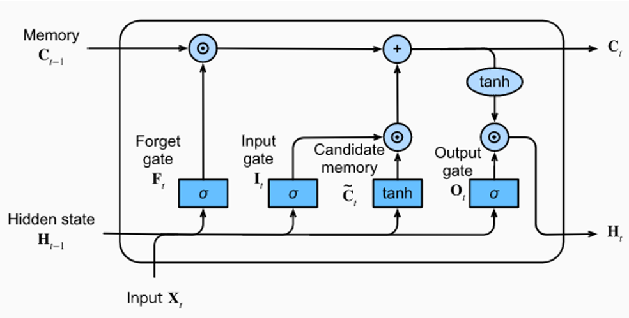
LSTM

Slide 12
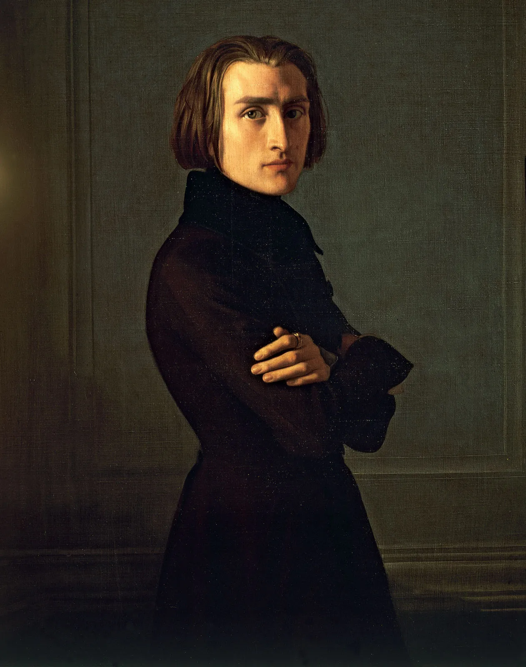
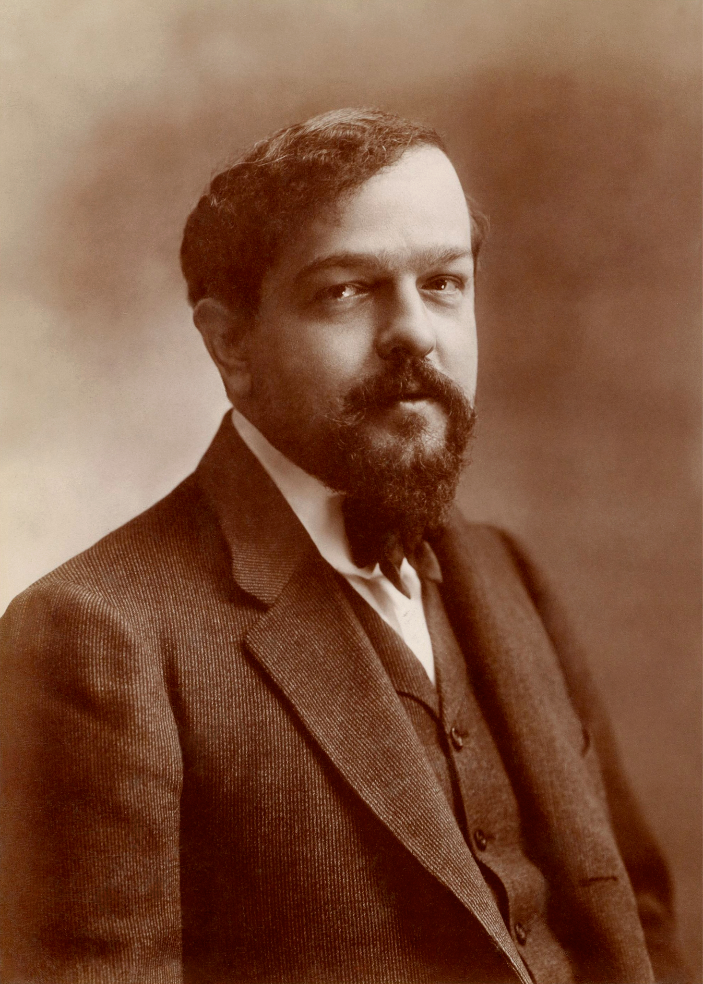

Data Source
Notes:
613,548 Notes & chords aka Datapoints from a library database of open source and license romantic music pieces. The data was parsed through for each note (not including rests) and converted into frequency data for use

Slide 13
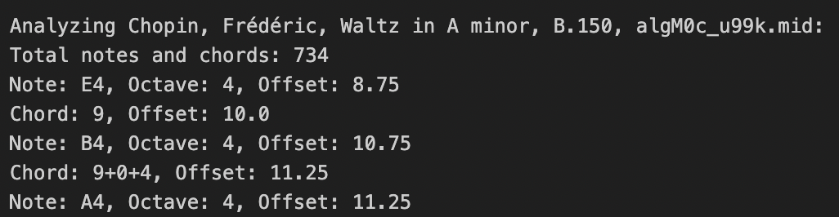
Data
Took a subset of GiantMIDI Piano
171 Romantic piano .midi files
Lizst, Debussy, Chopin
Split data into two objects
Notes and Chords
Pitch, Octave and Offset

Slide 14
Neural Network Structure
Layers:
3 LSTM Layers
First two LSTM layers use return_sequences=True to pass the sequence of outputs to the next layer
Last one consolidates the information into a single output vector
Batch Normalization Layers and Dropout Layers to mitigate possible overfitting
2 Dense Layers
First one serves as transition layer, second maps representation to size of vocab, prepping for softmax activation
ReLU Activation
Introduces non-linearity to the network, allowing it to learn complex patterns
Softmax
outputting probabilities for a specific note
Model Compilation
Loss function
Adapts the learning rate for each weight in the network

Slide 15
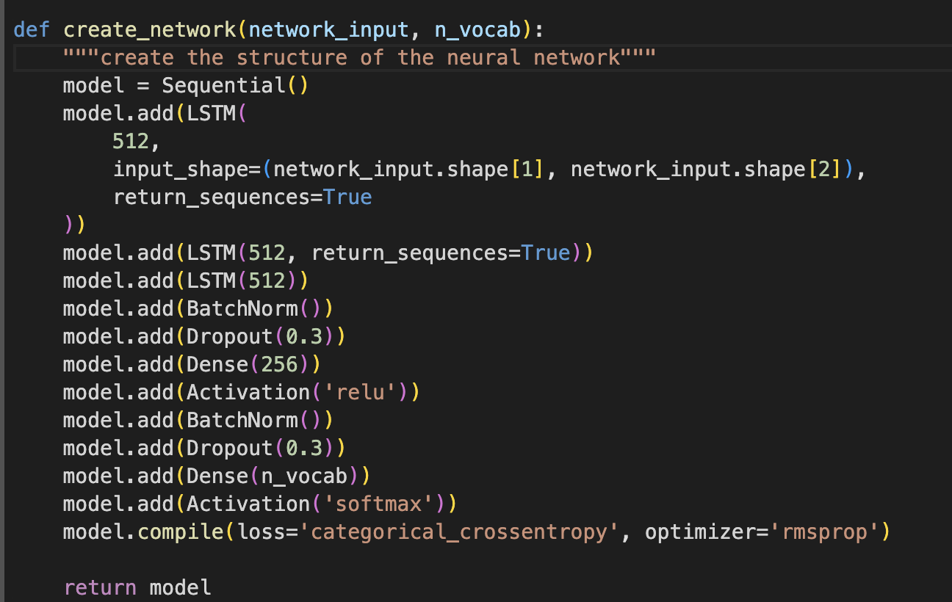
Neural Network Structure

Slide 16
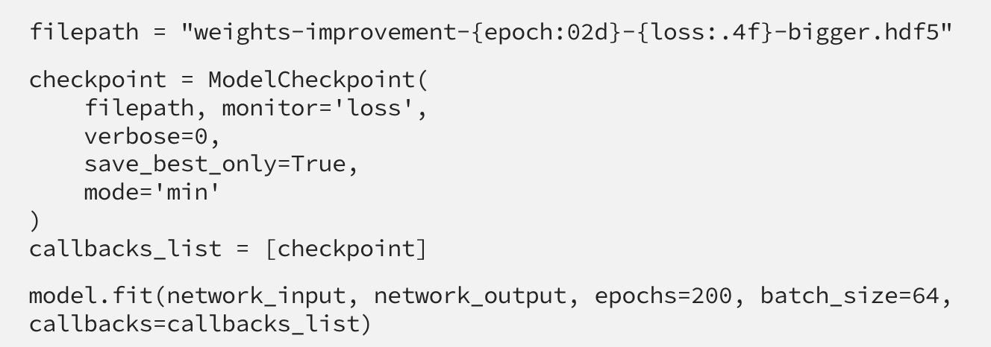
Training
Model.fit is used to train the network
ModelCheckpoint saves weights after every epoch

Slide 17
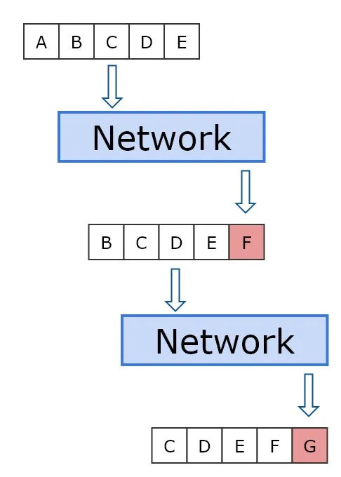
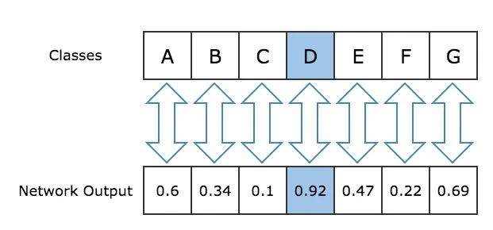
Utilizing Outputs to Generate Music
Load weights from training
Create a mapping function to decode the output of the network
Neural Network outputs probability of a note appearing at a certain time in a piece
Extract the index of the highest value
Place most likely note to appear in the newly generated piece
Collect all the outputs from the network into single array.

Slide 18
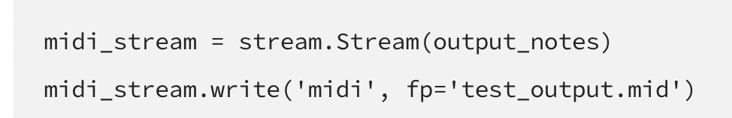
Utilizing Outputs to Generate Music
Now we can start decoding them into an creating an array of Note and Chord objects.
If Chord, we split the string up into an array of notes.
If Note, we create a Note object using the string representation
We then append the Note/Chord object created to a list.
We can create a Music21 Stream object using the list as a parameter.
Use music21 write toolkit to write stream to midi file

Slide 19
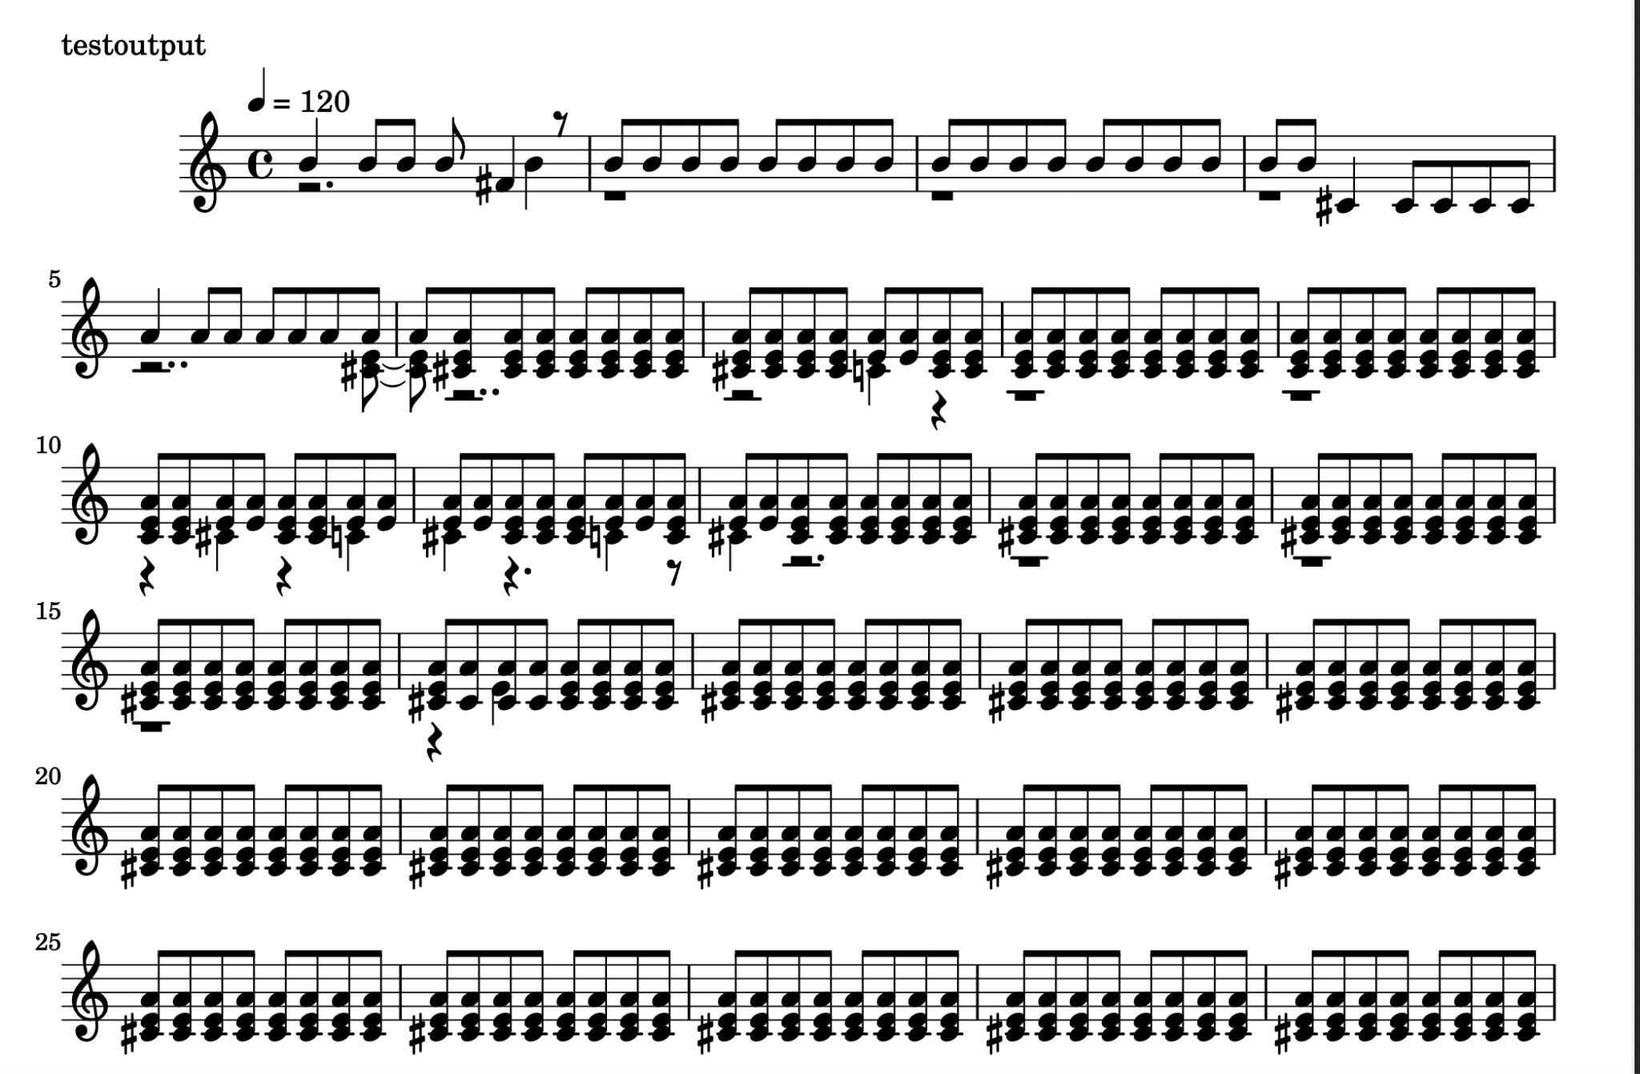
Findings
50 epochs, Sequence Length 100
Does not implement rests
Does not vary pitch, duration, and volume
All eighth notes, no key signature, no dynamics
Model has a tendency to fall into a loop
Likes to repeat patterns of notes over and over
Model interprets all notes in the same pitch

Slide 20
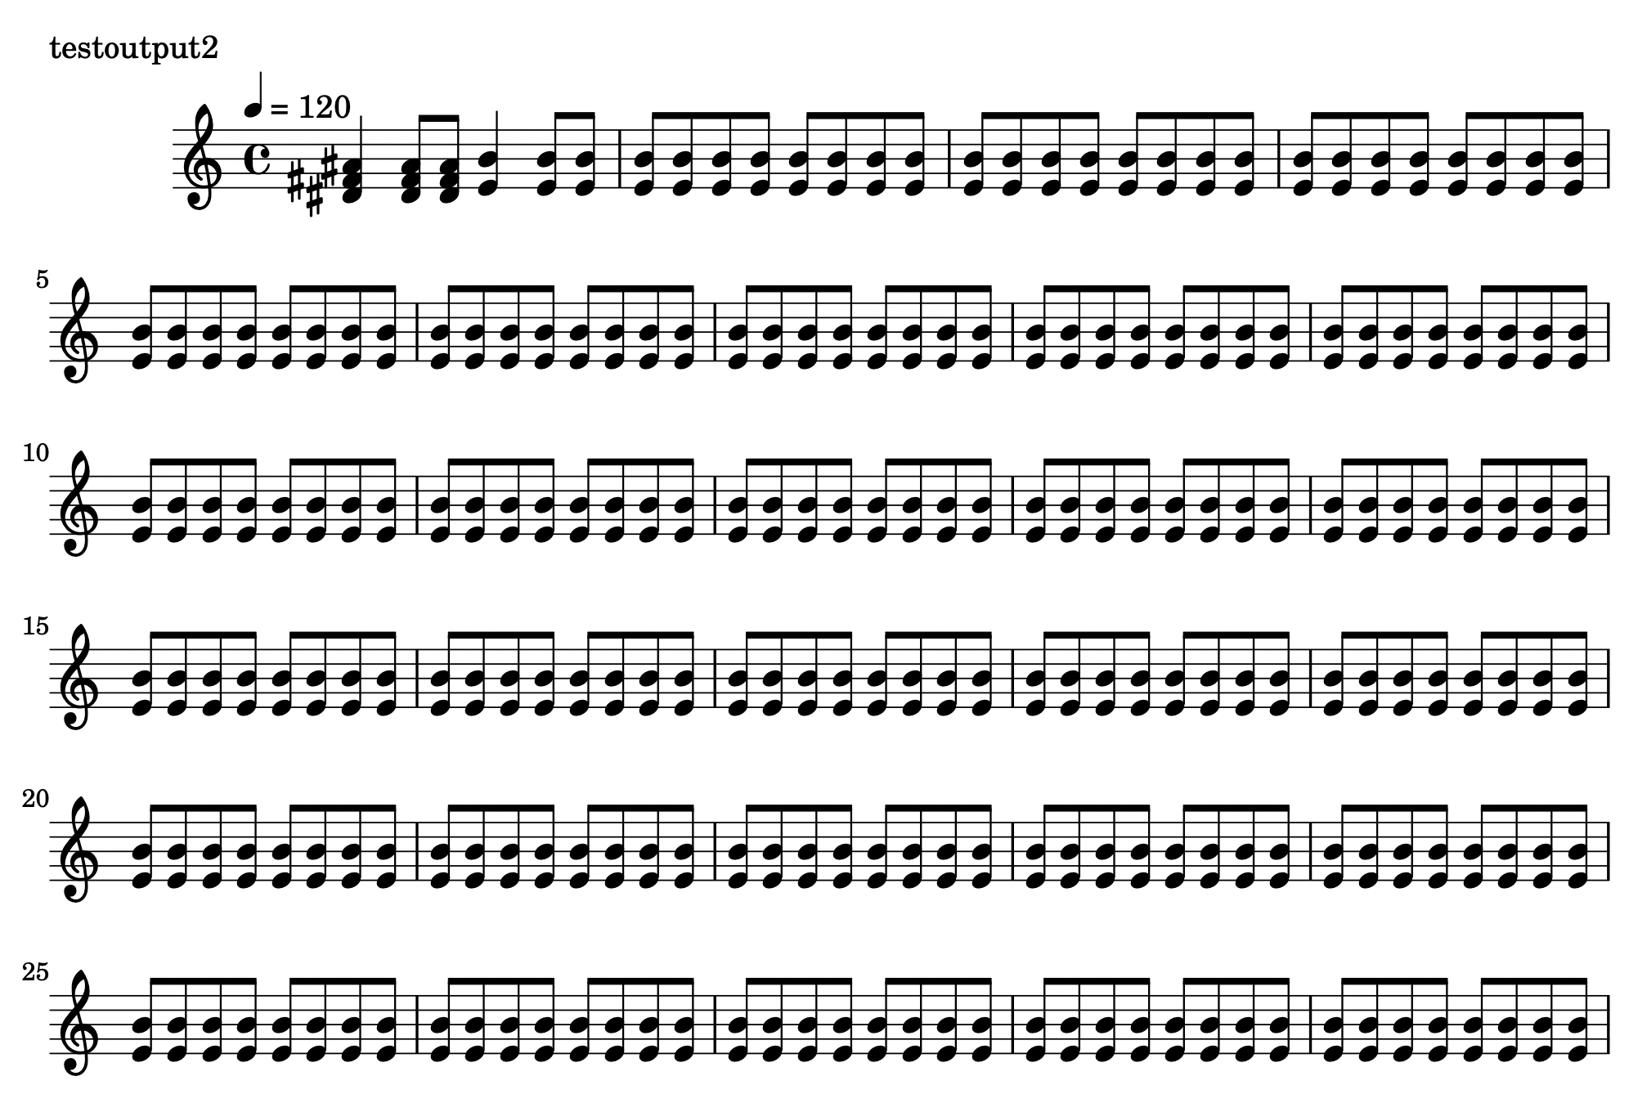
Findings
24 epochs (was supposed to be 200, but was terminated due to implementation of early stoppage) Sequence Length 10

Slide 21
Pieces
Run 1 (50 Epochs, Seq length 100)
https://soundcloud.com/luke-feng-897241151/output1-1?si=031a75c80dc6400c929587200471b6ee&utm_source=clipboard&utm_medium=text&utm_campaign=social_sharing
Run 2 (24 Epochs, Seq length 10)
https://soundcloud.com/luke-feng-897241151/output2-1?si=031a75c80dc6400c929587200471b6ee&utm_source=clipboard&utm_medium=text&utm_campaign=social_sharing

Slide 22
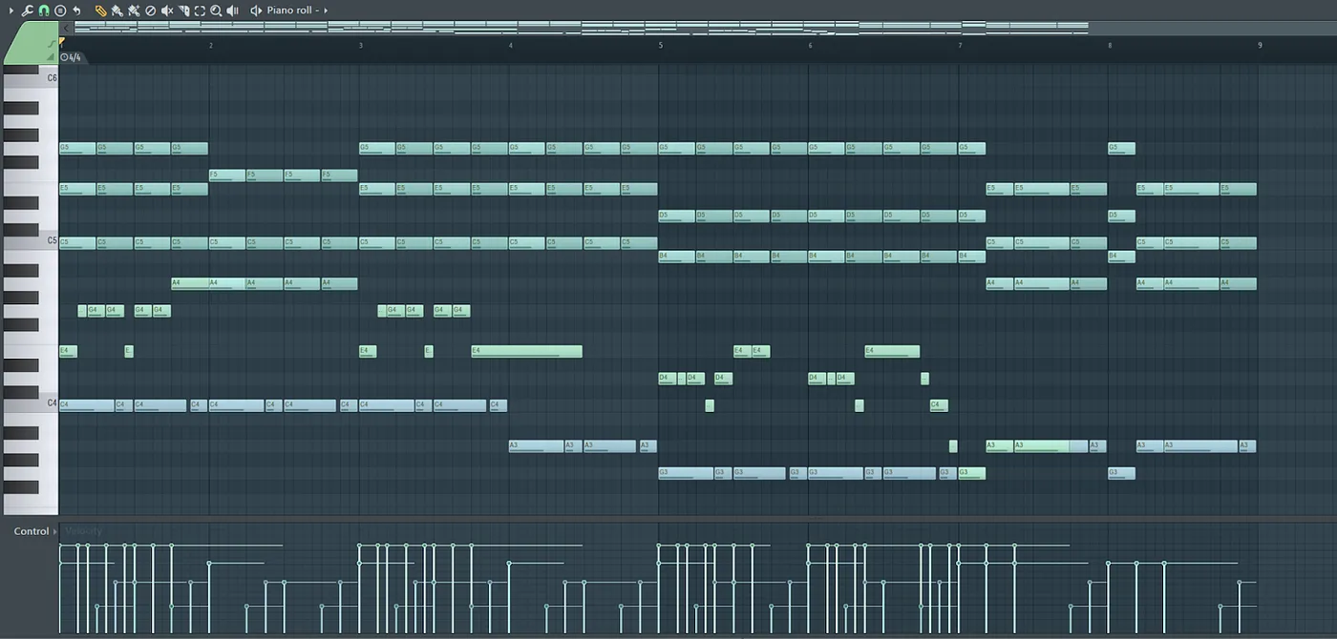
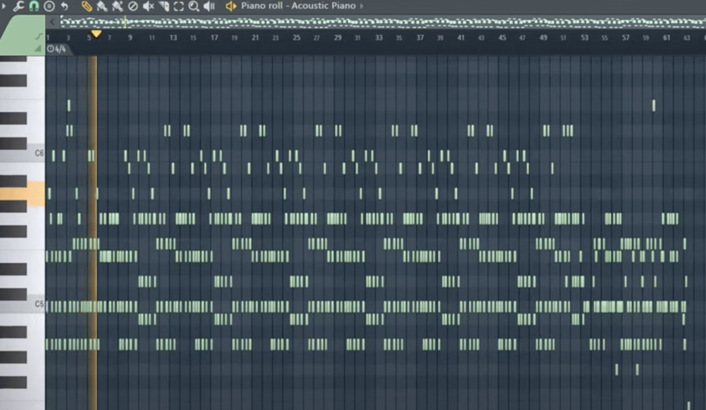
Cons of Tactic
Does not take into account Music Theory
No time signatures
No rhythm or tempo
No rests included
Use of Octaves, Arpeggios, etc not included
This results in robotic sounding “music” , more random sounds than music
Insert image of good song MID VS Insert IMage of LSTM

Slide 23
Future Plans for Final Project
Luke & Kevin
Also include music theory in data used to train machine
Add a positive feedback system so LSTM know what trends to make “good” music
Include two separate inputs into NN one for music theory and one for learning music writing

Slide 24
Bibliography
https://towardsdatascience.com/how-to-generate-music-using-a-lstm-neural-network-in-keras-68786834d4c5
https://victorzhou.com/blog/intro-to-rnns/

